Slide 1
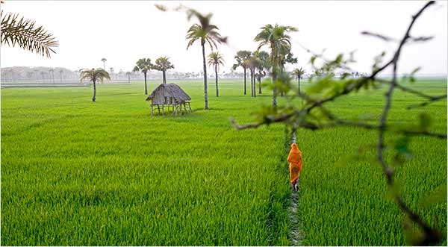

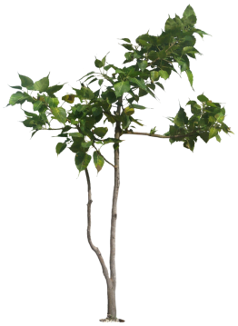
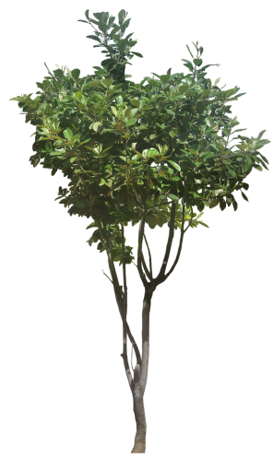
Assalamu Alaikum Warahmatullah
Notes:
Welcome slide.

Slide 2
Introduction
Md. Hasan Hafizur Rahman
Lecturer & Head of the Department (English) Cambrian School & College, Campus-5, Baridhara, Dhaka | Lesson Description Class-VIII English 2nd Paper
Notes:
Identity of teacher & lesson.

Slide 3

Let us observe some images.
Notes:
No need to click.

Slide 4
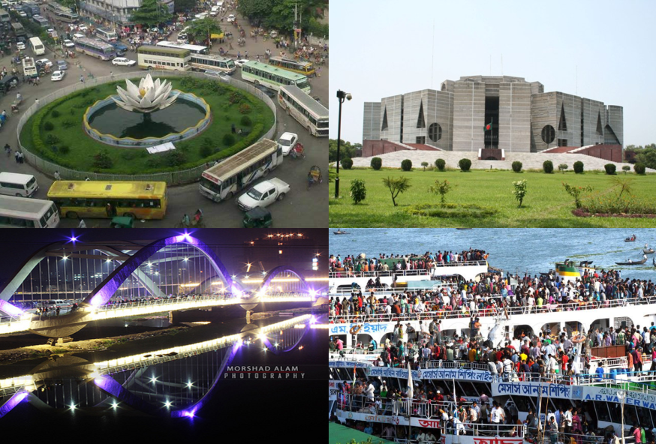
Dhaka is the capital of Bangladesh.
Notes:
An example of a proper noun.

Slide 5
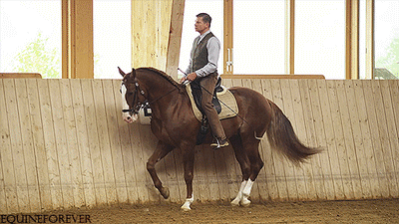
The horse is a faithful animal.
Notes:
An example of a common noun.

Slide 6
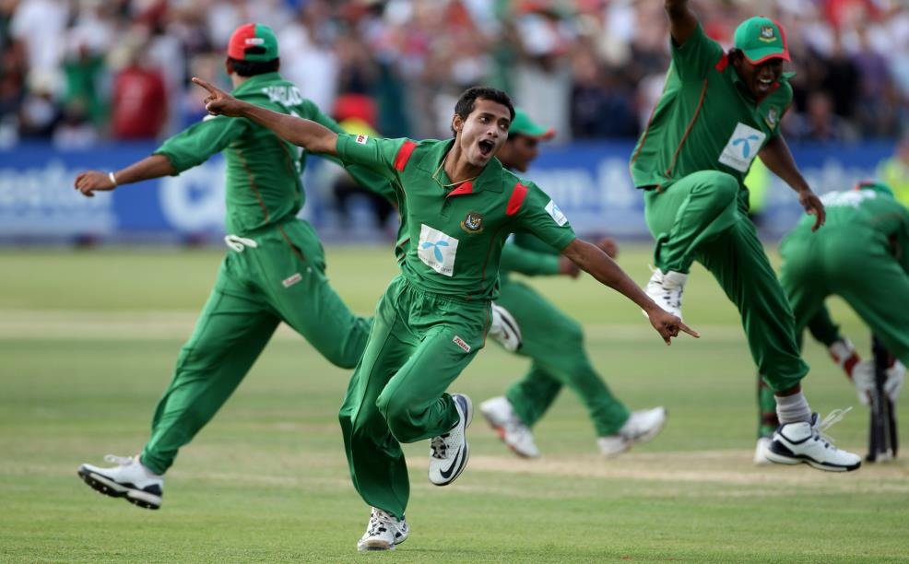
Our team has won the match.
Notes:
An example of a collective noun.

Slide 7
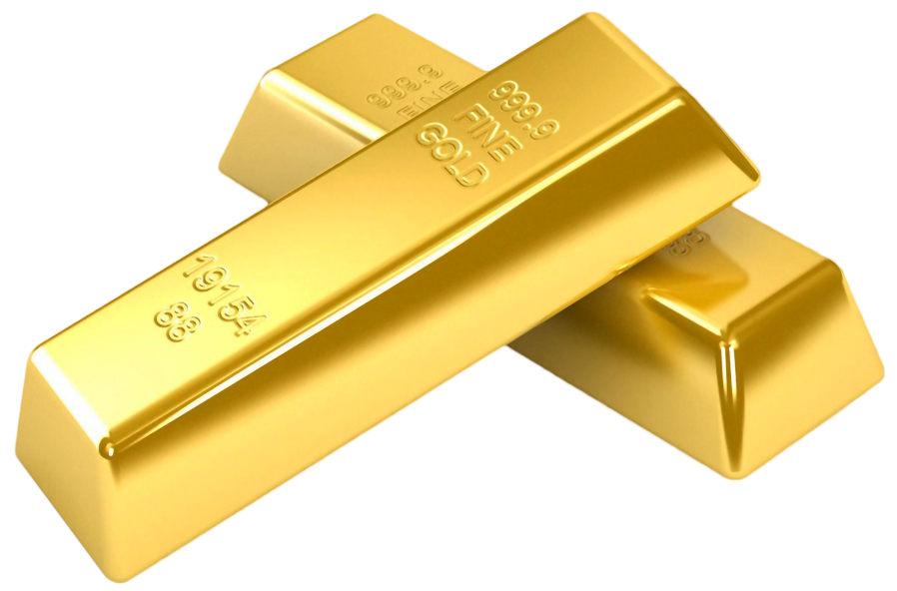
Gold is a precious metal.
Notes:
An example of a material noun.

Slide 8


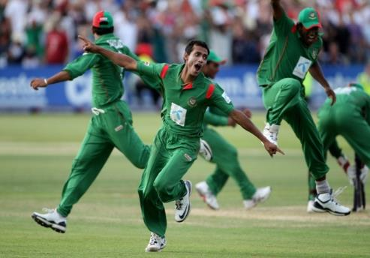
Dhaka
Horse, rider
Gold
Team
Notes:
All the four kinds of noun.

Slide 9



What have you observed?
Let us see what our today’s lesson is-
Four kinds of visible names.
Notes:
Four kinds of noun are shown.

Slide 10
Our Today’s lesson is-
Classification of concrete noun
Unit-1, Lesson-2
Notes:
Lesson declaration.

Slide 11
Learning outcomes
After we have studied this unit, we will be able to ---
define concrete noun
identify the classification of concrete noun
identify four kinds of nouns
Notes:
Aims of this lesson.

Slide 12
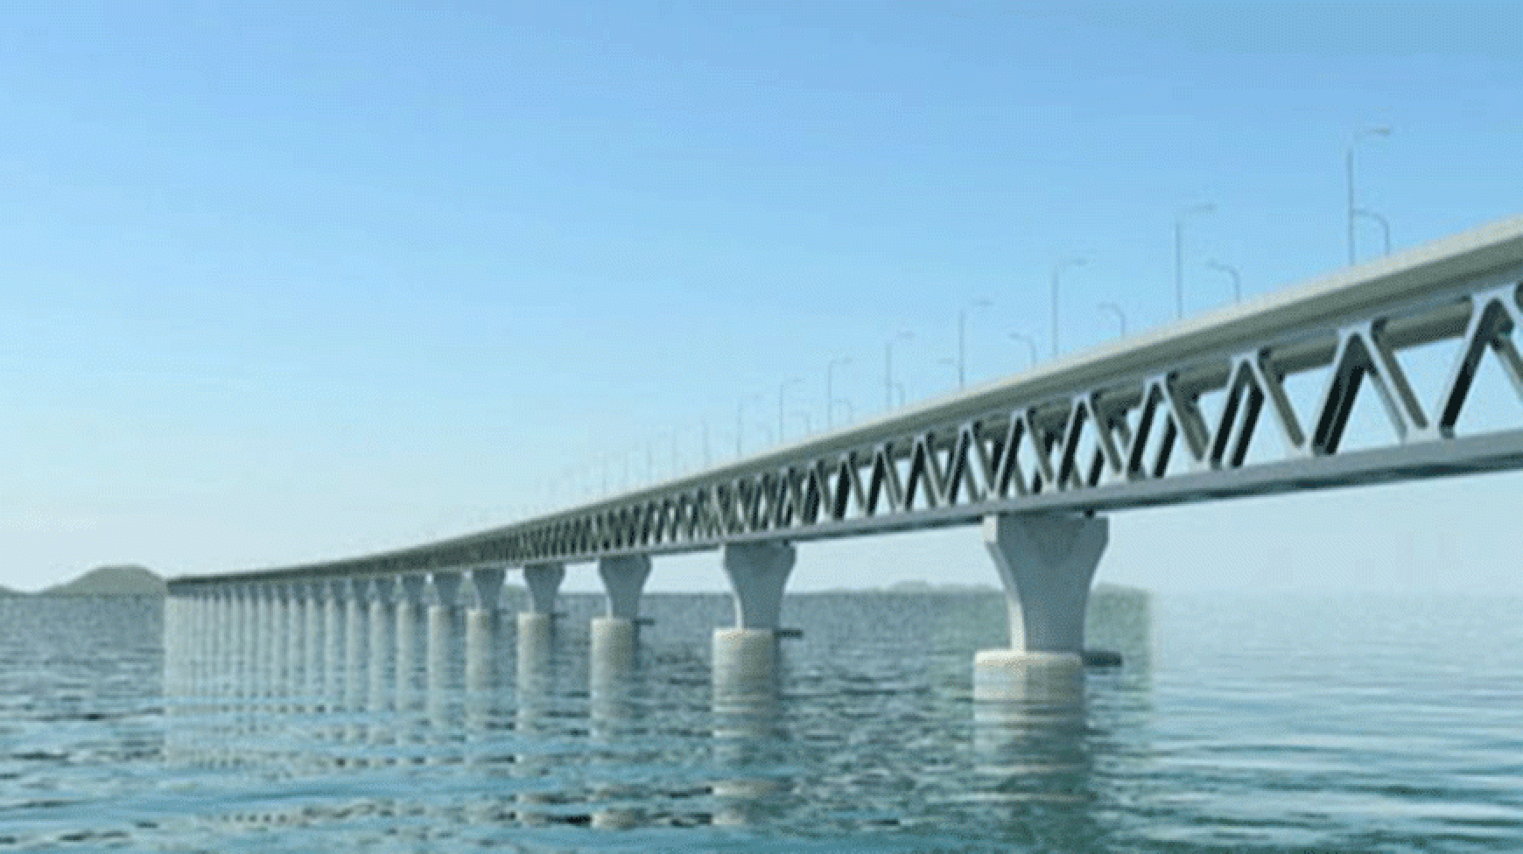
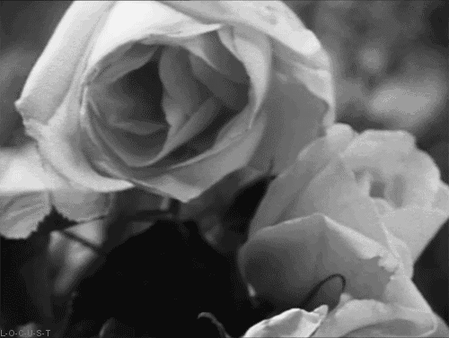
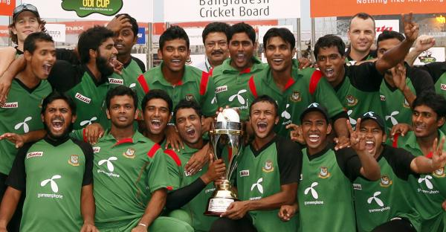
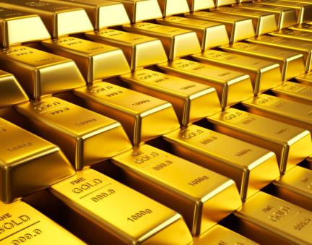
Padma bridge
Flower
What have you observed by the pictures?
Team
Gold
Notes:
Four nouns are shown in this page.

Slide 13
Concrete nouns are classified into four categories----
Proper noun
Common Noun
Collective Noun
Material Noun
Let us discuss concrete nouns in details.
Notes:
Concrete noun is divided into four kinds.

Slide 14

Proper Noun
Ln MK Bashar
Specific name of a person
To mean something as specified name, object, place etc. are called proper noun.
Notes:
Teacher may discuss it elaborately.

Slide 15
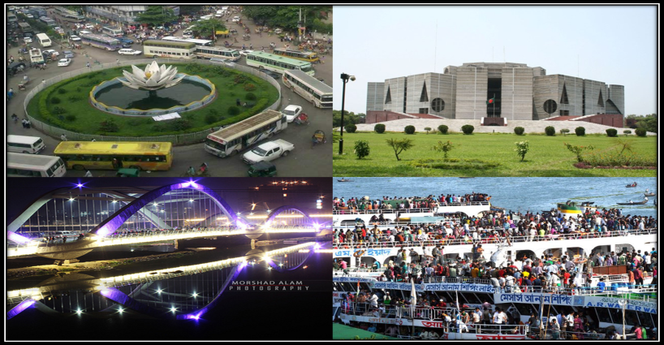
Dhaka
Specific name of a place
Proper Noun
Notes:
Teacher may conduct it as he likes.

Slide 16
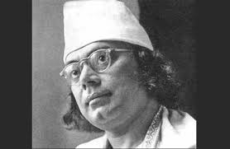
Every general name of something like man or other thing is called common noun.
Common Noun
Common name of a group.
Kazi Nazrul Islam is a great poet.
Common Noun
Notes:
Teacher may discuss common noun elaborately.

Slide 17

Common name of flowers.
The rose is a beautiful flower.
Common Noun
Notes:
Continuation of the above.

Slide 18
To get idea clear more -
Common Noun | Proper Noun
Man (মানুষের সাধারণ নাম) | Rahim, Karim (নির্দিষ্ট মানুষের নাম)
Girl (বালিকাদের সাধারণ নাম) | Luna, Tania (নির্দিষ্ট বালিকাদের নাম)
City (শহরের সাধারণ নাম) | Dhaka, Khulna (নির্দিষ্ট শহরের নাম)
River (নদীর সাধারণ নাম) | Padma, Surma (নির্দিষ্ট নদীর নাম)
Notes:
Teacher may discuss it specifically.

Slide 19
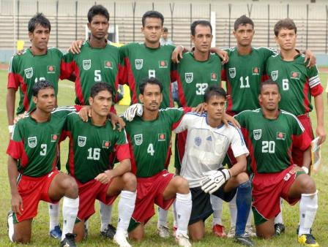
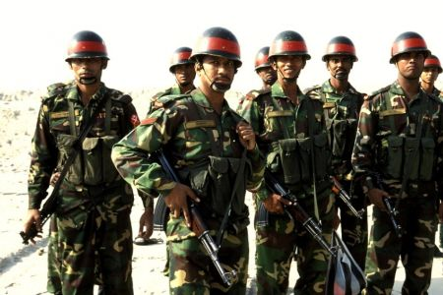
Our team won the match.
He joined the army.
Notes:
Teacher may discuss it elaborately.

Slide 20
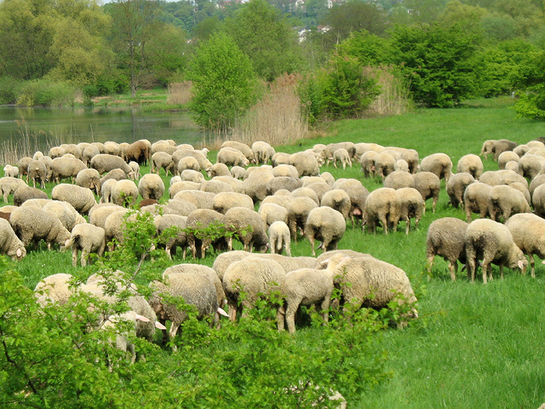
A flock of sheep is grazing in the field.
Notes:
Continuation of the above.

Slide 21
What do you mean by the following words?
Army
Team
Flock
A collection of soldiers
A collection of players
A collection of sheep
Names of collection.
That means collective noun.
The word that refers a collection of people or things like soldier, police, lawyer, platoon, player and so on that appear singular in formal shape but can be used in plural shape also are called collective noun.
Notes:
Teacher may discuss it elaborately.

Slide 22
To get idea clear more -
Common Noun | Collective Noun
Sheep (ভেড়ার সাধারণ নাম) | A flock of sheep এক পাল ভেড়া
player (খেলোয়াড়দের সাধারণ নাম) | Team ( খেলোয়াড়দের সমষ্টি)
Robbers (ডাকাতের সাধারণ নাম) | Gang (ডাকাতের সমষ্টি)
flowers (ফুলের সাধারণ নাম) | Bunch (এক গুচ্ছ)
Notes:
Teacher may clear it.

Slide 23
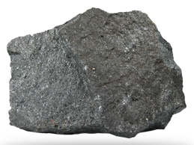

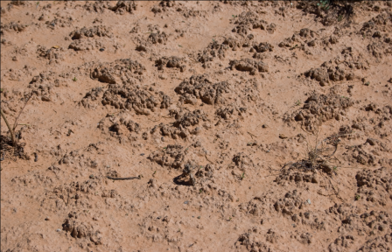
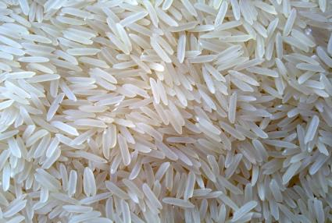
Iron
Water
Soil
Rice
Notes:
Examples of material noun.

Slide 24
What do you mean by the pictures?
Name of some materials that means material noun.
Material Noun is the name of a material or a substance or an ingredient of an alloy (ধাতব উপাদান).
Notes:
Teacher may take out the name of material noun from the students.

Slide 25
To get idea clear more -
Material Noun | Common Noun
Gold (অখন্ডনীয়) | Ring (Not whole, a piece of gold)
Wood (অখন্ডনীয়) | Bench (Not whole, a piece of wood)
Milk (অখন্ডনীয়) | Ghee (Not whole, a portion of milk)
Notes:
The difference between material & common noun.

Slide 26
Individual Work
Identify the nouns of the following sentences.
I Love my mother other than everything in the world.
He presented me a bunch of flowers.
Mr. Jillian is a European.
Milk is a nutritious food.
Passion to Allah is the way to heaven.
Notes:
Class activities.

Slide 27
Feedback
Answer the following questions
What is a proper noun?
What do you mean by common?
What is the Bengali meaning of alloy?
What is object?
What kind noun is ‘crowd’?
Notes:
Evaluation.

Slide 28
Work
Write at least five examples of each noun what you see around you.
Notes:
Assignment at home.

Slide 29
Verse Universal
Know thyself.
Notes:
An advice .

Slide 30
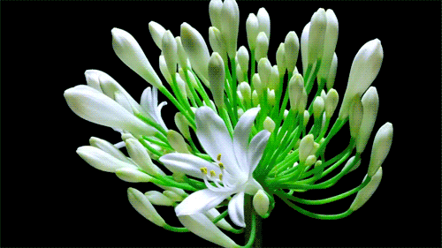
May Allah bless you.
Notes:
Ending slide.

Slide 31
Acknowledgement
We would like to express our cordial gratitude to the Ministry of Education, Directorate of Secondary & Higher Education, NCTB, A2i and the panel of honorable editors ( Md. Jahangir Hasan, Assistant Professor (English) TTC, Rangpur, Ranjit Poddar, Associate Professor (English) TTC, Dhaka, and Urmila khaled, Assistant Professor (English) TTC, Dhaka, to enrich the contents.

